Slide 1
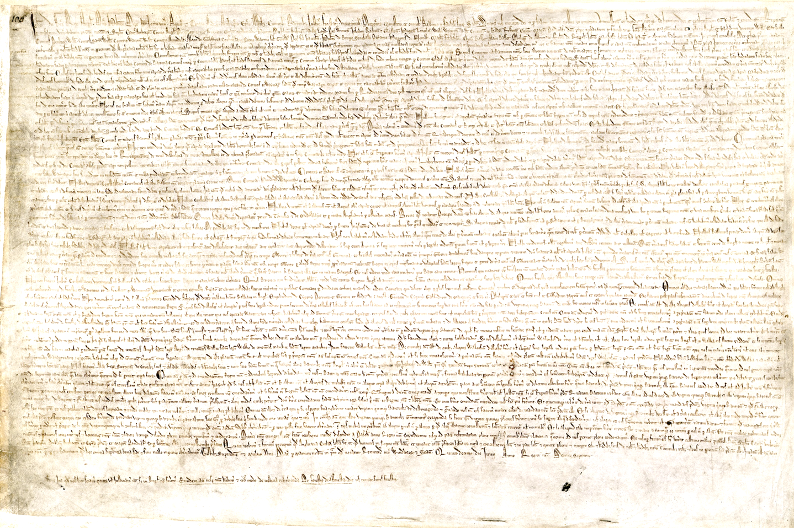
A Universal Charter? The Legacy of Magna Carta
Sir Robert Rogers,
House of Commons

Slide 2
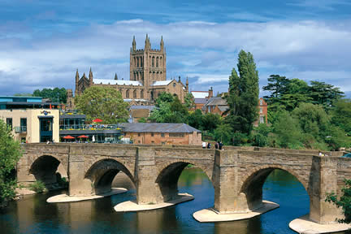

Slide 3
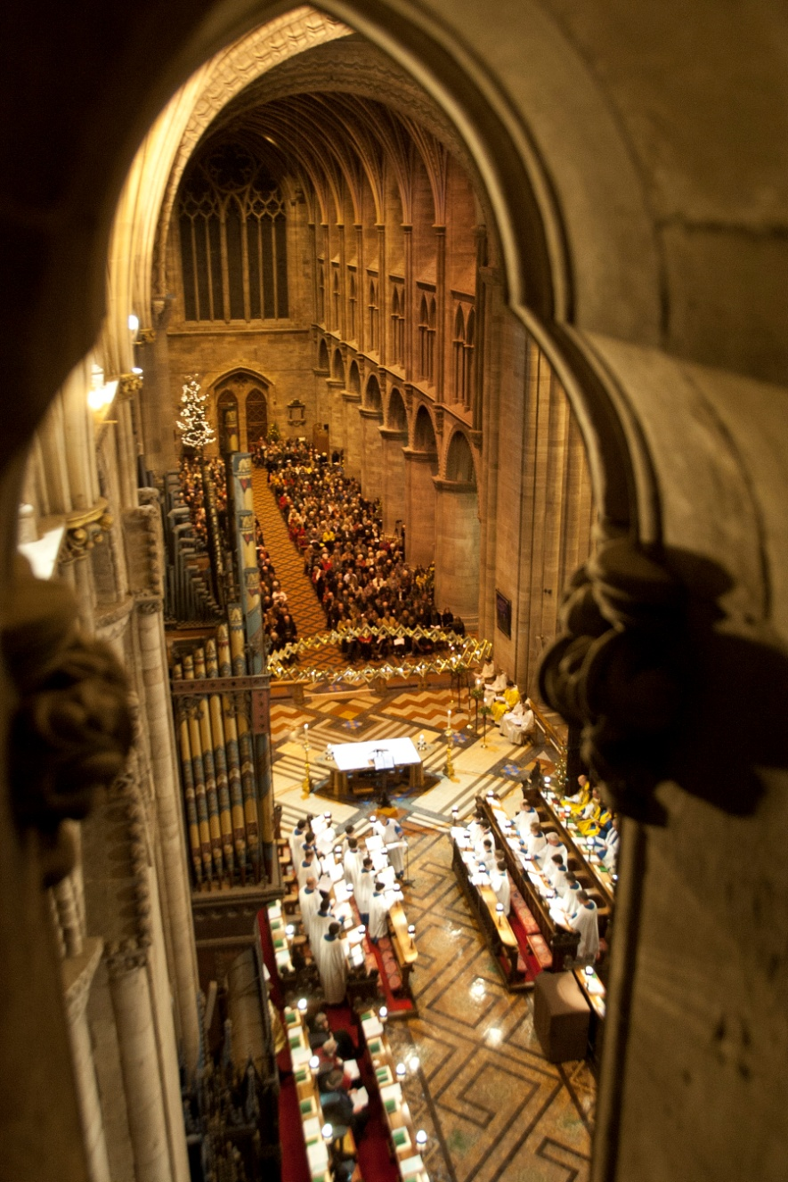

Slide 4
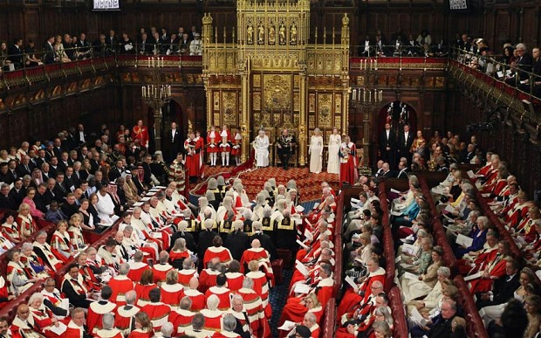

Slide 5
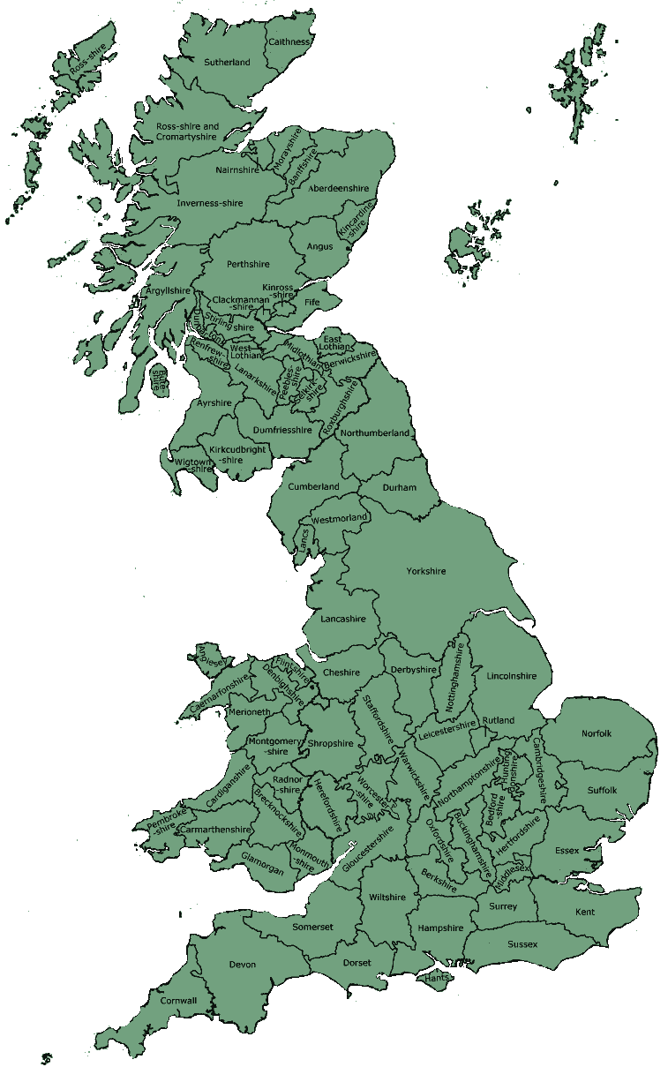

Slide 6
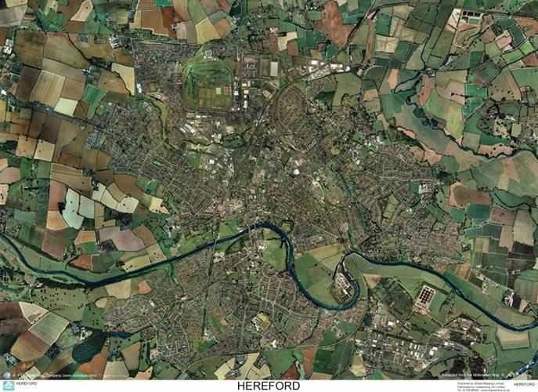
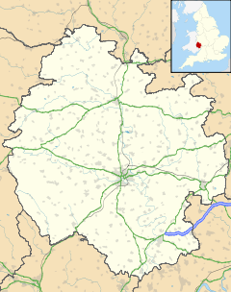
HEREFORD

Slide 7
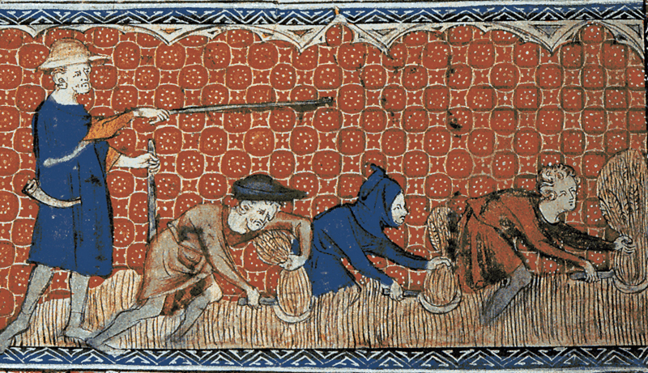

Slide 8
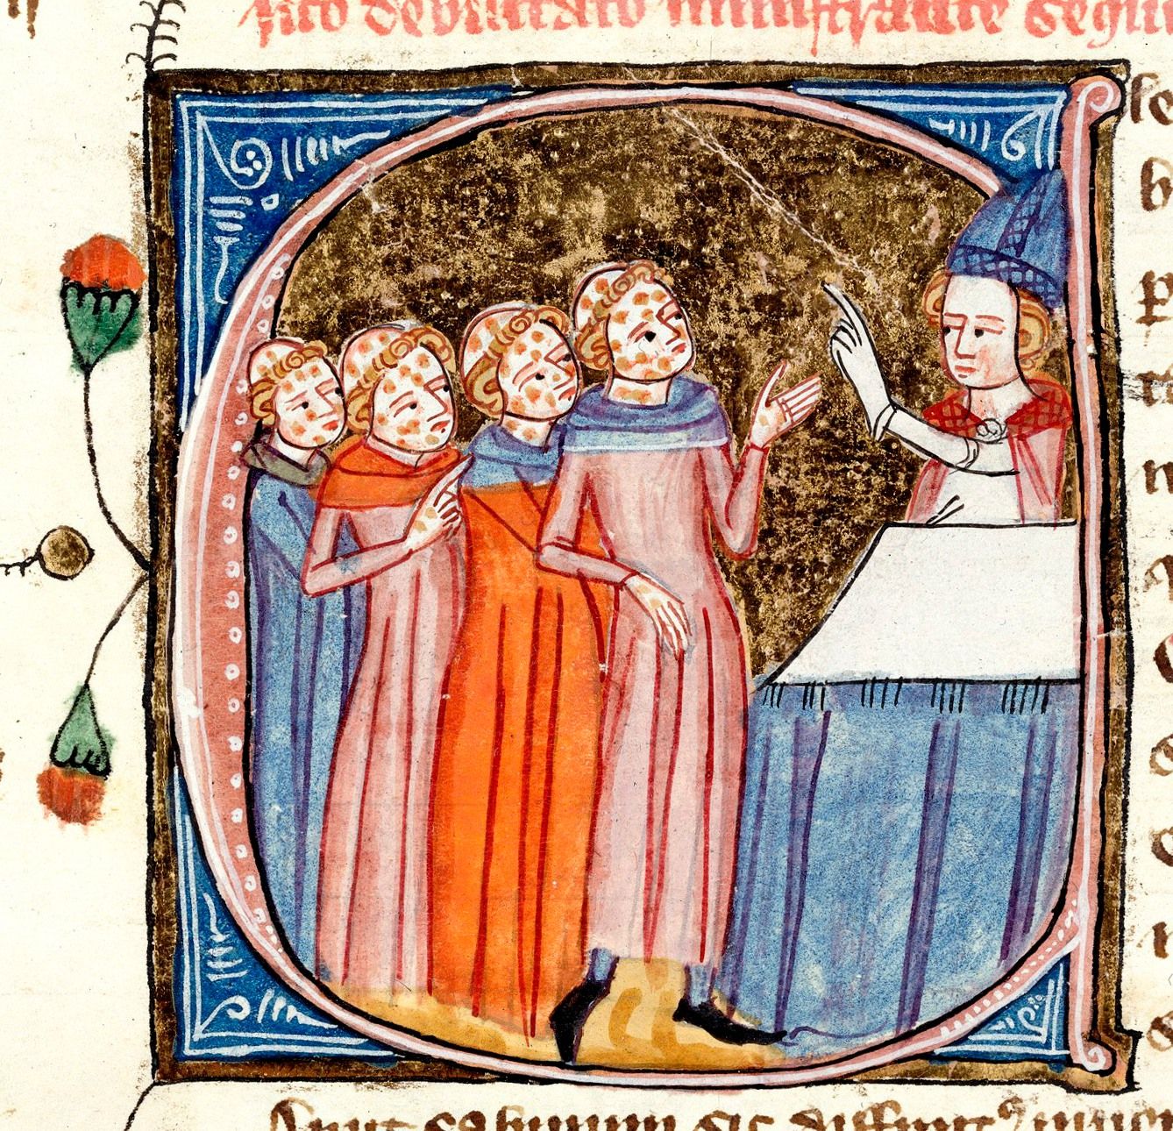

Slide 9
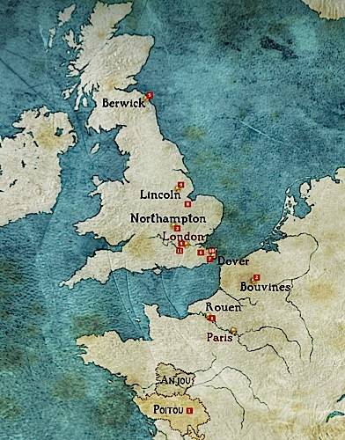

Slide 10
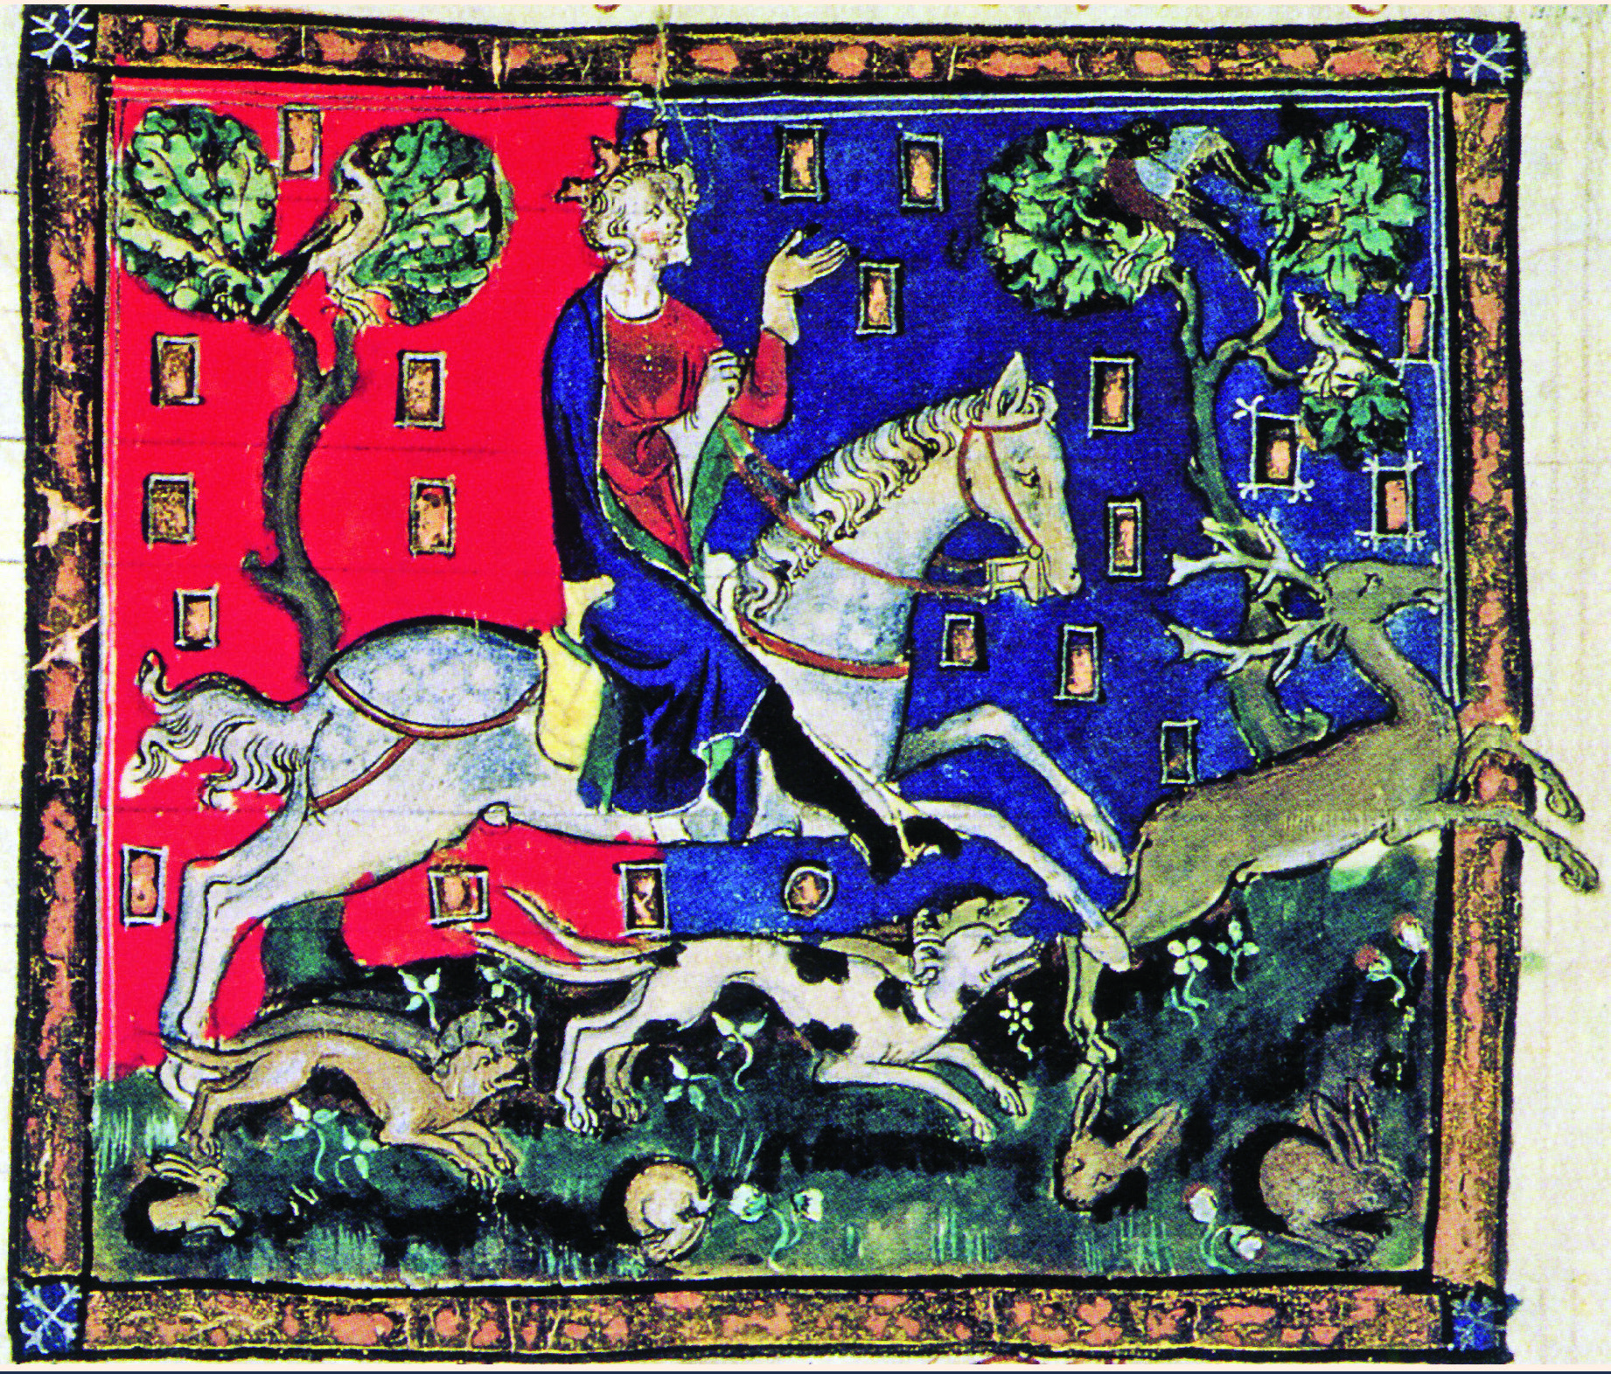

Slide 12
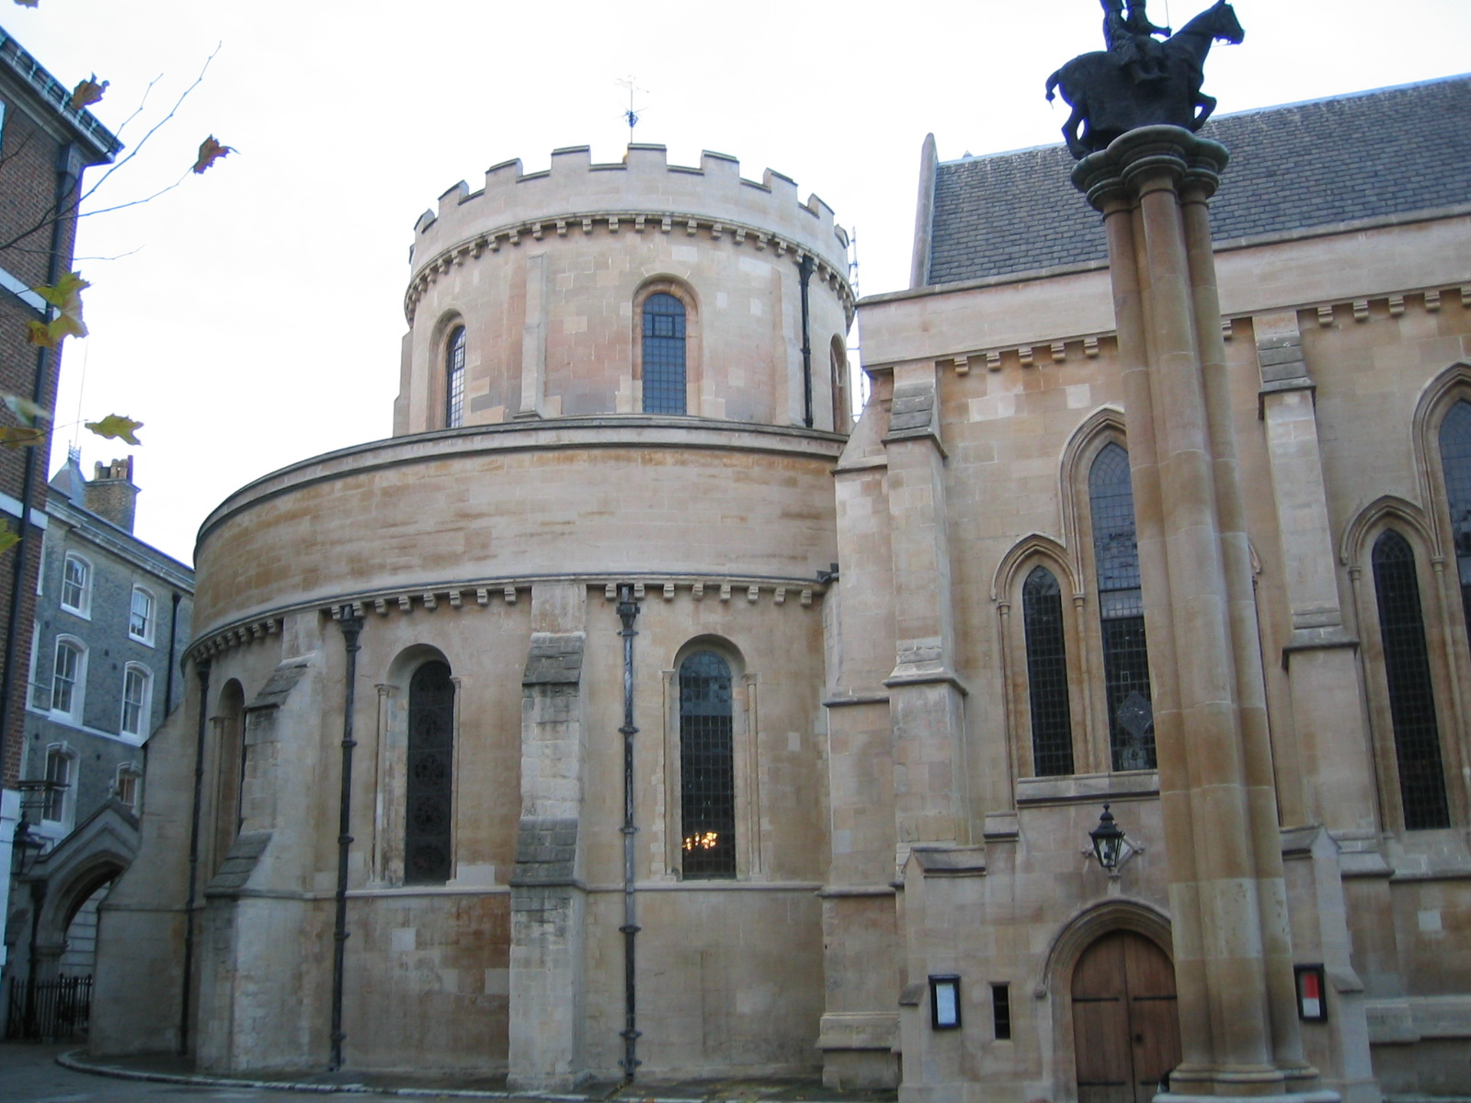

Slide 14
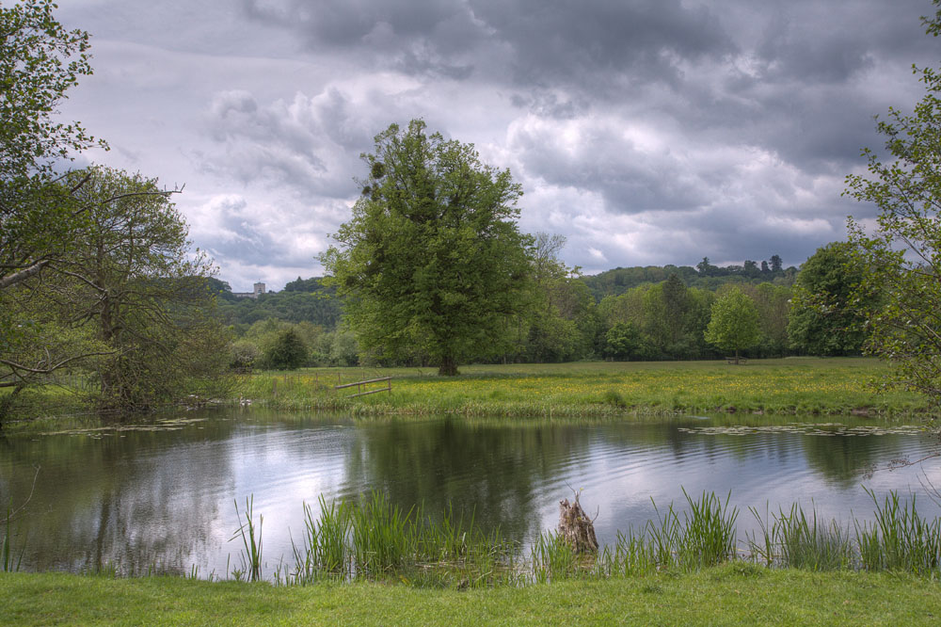

Slide 15
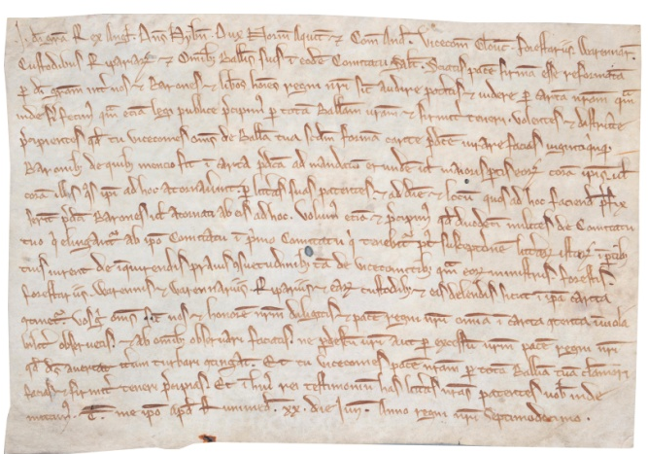
King John’s Writ, 1215

Slide 16
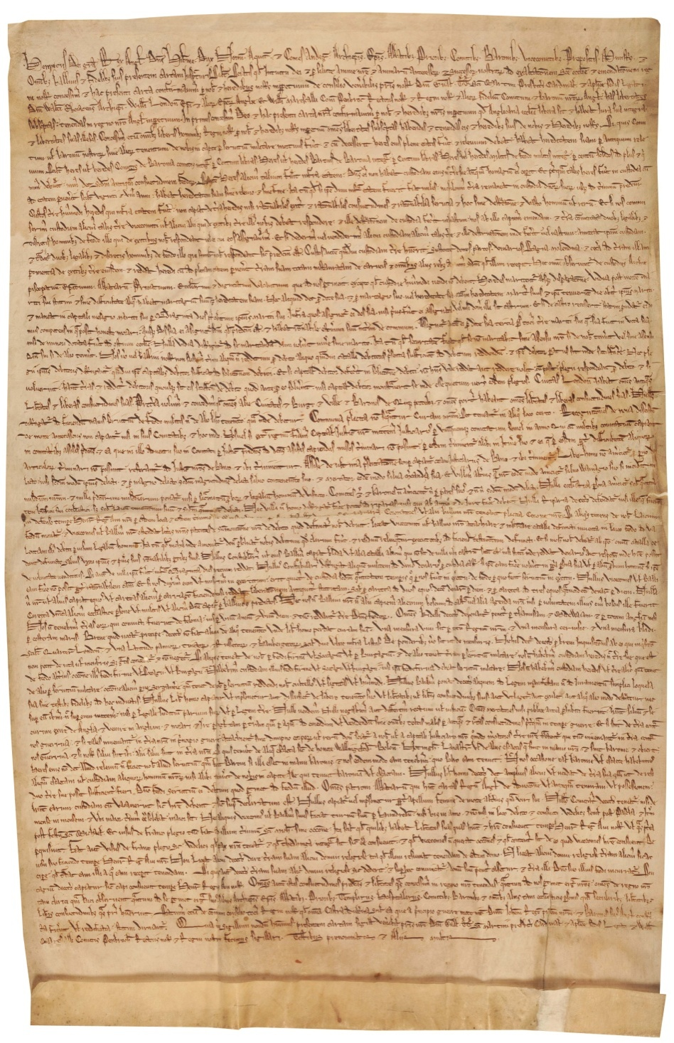

Slide 17
CLAUSE 32
No free man shall be taken or imprisoned, or dispossessed, of his free tenement, or liberties, or free customs, or be outlawed, or exiled, or in any way destroyed; nor will we condemn him, nor will we commit him to prison, excepting by the legal judgement of his peers, or by the laws of the land.

Slide 18
CLAUSE 33
To none will we sell, to none will we deny, to none will we delay right or justice.

Slide 20
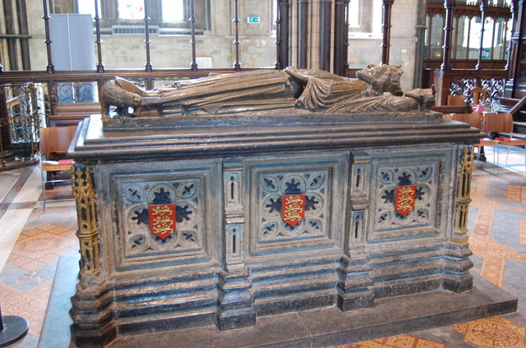
King John’s Tomb in Worcester Cathedral

Slide 21
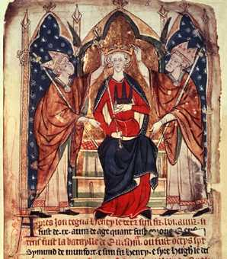
Henry III

Slide 22
MAGNA CARTA
1217

Slide 23
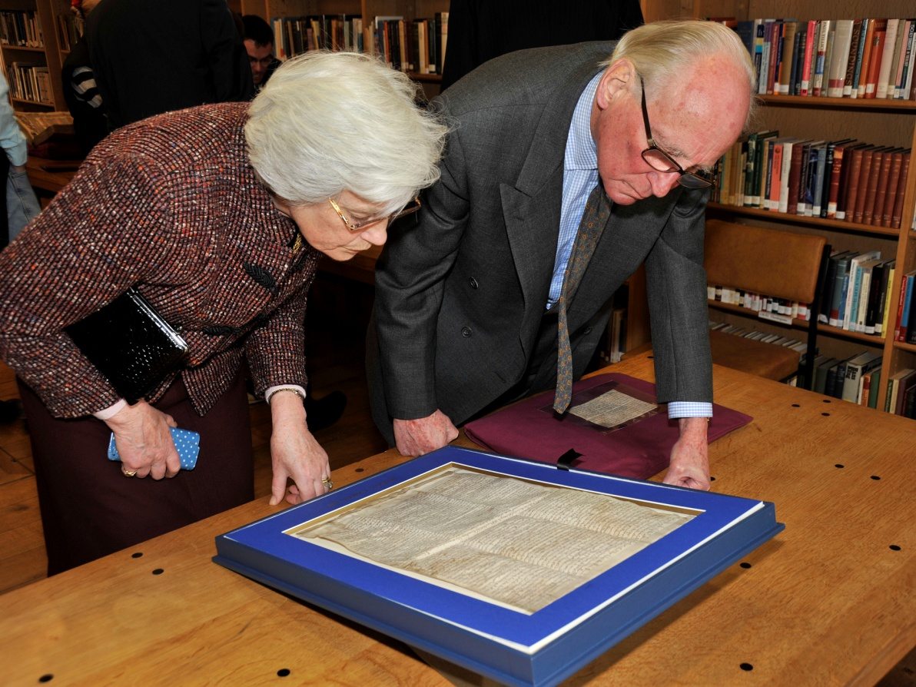

Slide 24
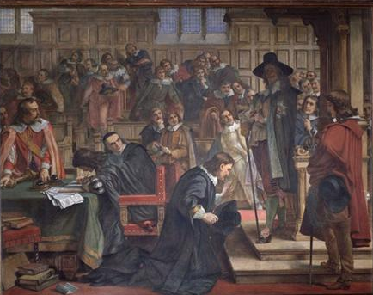

Slide 25
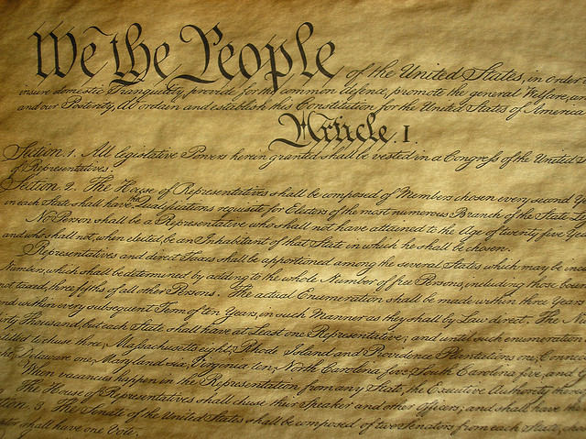

Slide 26
